Slide 1
Student Information Management System
Created By:
Paul, Adrian, Edson, Haoma, Carl

Slide 2
The Project Objective
The Software program has to have the following computerized system to help the university IT department improve and manage their services to track student basic information.

Slide 3
Project Description:
The student information management system deals with all kind of student details, academic related reports, college details, curriculum, batch details and other resource related details too.
It tracks all the details of a student from day one to the end of his course which can be used to reporting purpose, tracking of attendance, progress in the course, completed semester years, coming semester year curriculum details, exams details, project or any other assignment details, final exam result etc.

Slide 4
Management Team:
How many members are in your team?
5 members
Paul: Programmer
Adrian: Programmer
Edson: Programmer
Haoma: Programmer
Carl: Programmer

Slide 5
What type of team model is used in this project?
Democratic Team Approach
The project work is equally separated among team members so all team members have a say in how the program will be run and the direction it will be going.

Slide 6
Programming Team:
Paul:Programmer
It will handle the documentation, programming code, the research and the direction and time frame to meet the programs goals and expectation to satisfied the customer needs.

Slide 7
Programming Team:
Adrian: Programmer
Will focus on documentation and research on the material
Edson: Programmer
Will focus on research and development in the programming code.
Haoma: Programmer
Will focus on research and development in the programming code.
Carl: Programmer
Will retouch the program and documentation as needed.

Slide 8
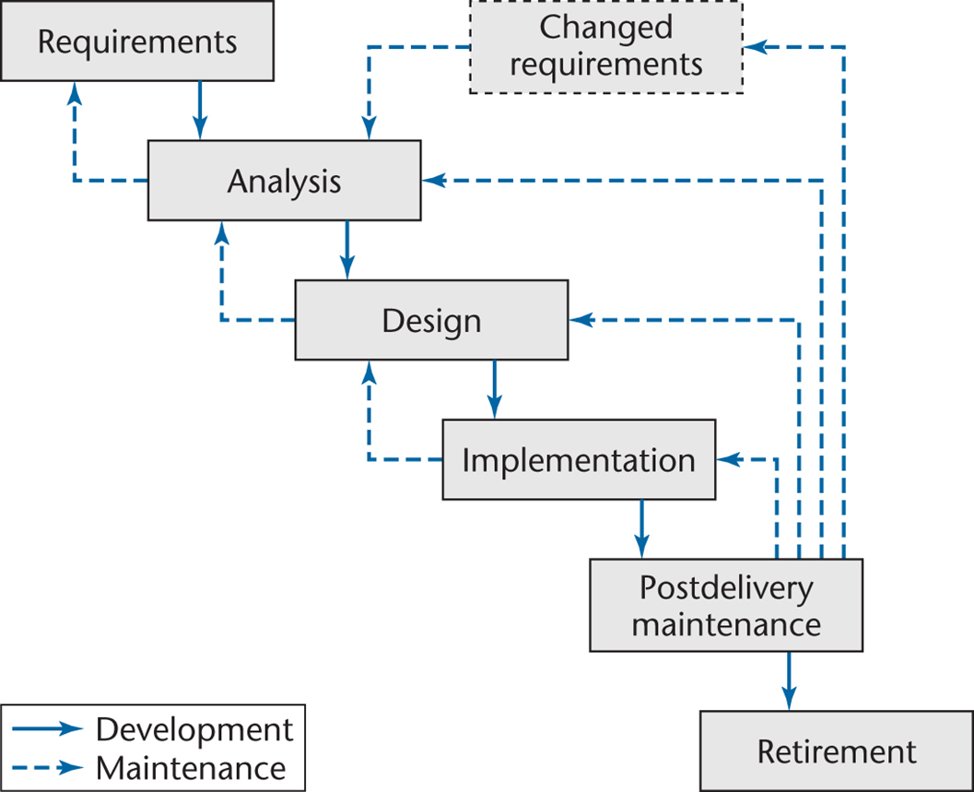
Waterfall Life-Cycle: Model
Waterfall Life-Cycle Model:

Slide 9
Waterfall Life-Cycle: Model
Waterfall Life-Cycle Model:
Definition:
It requires pre-planning and makes the process of development easy because it catches all flaws and errors which are going to occur during the developmental phase and how to handle them efficiently.

Slide 10
Waterfall Life-Cycle: Model
User Requirements:
The software system only stores and retrieves student partial information in the current semester and other basic information:
Student Name
Student ID
Register Course in the Current Semester
Each exam score in one course
GPA Calculation in the current semester

Slide 11
Waterfall Life-Cycle: Model
System and Analysis Specification:
Window 10 software
C++ Programming Code
Visual Studio
Internet Explorer
GitHub

Slide 12
Waterfall Life-Cycle: Design Phase
Business Case Requirement:
Business Case- a justification for a proposed project or undertaking on the basis of its expected commercial benefit.
For the educational institution, to register student quickly and effectively for meeting the academic requirements, institutional fees, and other financial capital.

Slide 13
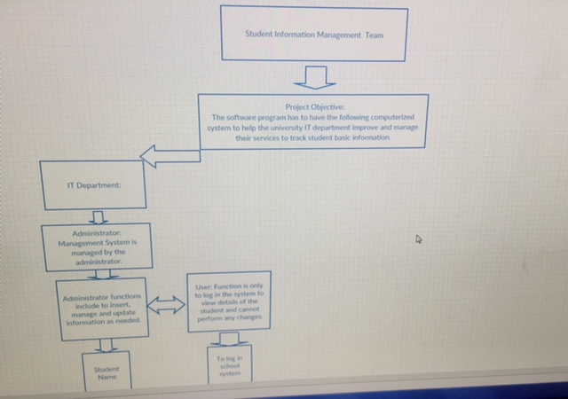
Waterfall Life-Cycle: Design Phase
Design Specification:

Slide 14
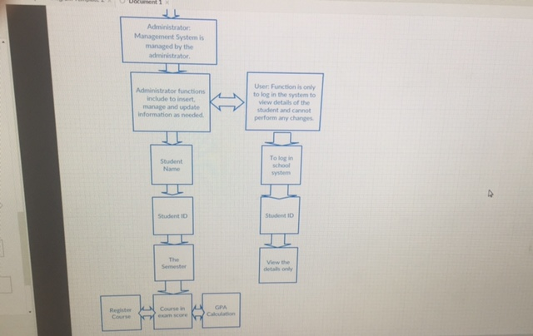
Waterfall Life-Cycle Model: Design Phase
Design Specification:

Slide 15
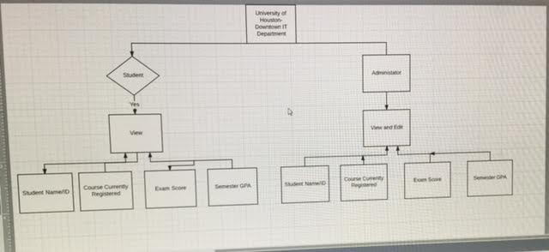
Waterfall Life-Cycle Model: Design Phase

Slide 16
Waterfall Life-Cycle Model: Database
DATABASE GLOSSARY:
A database is a collection of information that is organized so that it can be easily accessed, managed and updated.

Slide 17
Waterfall Life-Cycle Model: Database
Computer Science- The study of computing, programming, and computation in correspondence with computer systems. This field of study utilizes theories on how computers work to design, test, and analyze concepts
Grade- Grading in education is the process of applying standardized measurements of varying levels of achievement in a course.
Semester- applies when a student is attending the school year in either semester to complete a certain number of hours.
Course- is the student academic workload that he is trying to accomplish per semester.

Slide 18
Waterfall Life-Cycle Model: Database
Administrator- is an individual who is charge of organization or has the authority to make changes according to regulation and policy.
Student- is an individual who goes to institution for the purpose for higher learning to get a degree or certification.
Class- is subject or place where student get around and learn a subject taught by administrator or school official.
Exam- is an assessment intended to measure a test-taker's knowledge, skill, aptitude, physical fitness, or classification in many other topics.

Slide 19
Waterfall Life-Cycle Model: Database
Democratic Team Approach- The project work is equally separated among team members so all team members have a say in how the program will be run and the direction it will be going.
Waterfall Life-Cycle Model- It requires pre-planning and makes the process of development easy because it catches all flaws and errors which are going to occur during the developmental phase and how to handle them efficiently.
User- The software system only stores and retrieves student partial information in the current semester and other basic information:
Software engineering- Software engineering (SE) is the application of engineering to the development of software in a systematic method.

Slide 20
Waterfall Life-Cycle Model: Database
UML-Method- the Unified Modeling Language (UML) is a standardized way of specifying, visualizing, and documenting the artifacts of an object-oriented software under development (among other things.
Version Control- A component of software configuration management, version control, also known as revision control or source control, is the management of changes to documents, computer programs, large web sites, and other collections of information.
Graphical user interface (GUI)- a visual way of interacting with a computer using items such as windows, icons, and menus, used by most modern operating systems.

Slide 21
Waterfall Life-Cycle Model: Use Case Diagrams
Business Model:
An academic institution, computer, monitor, mouse, documentation, academic IT personnel
Customer Model:
Students

Slide 22
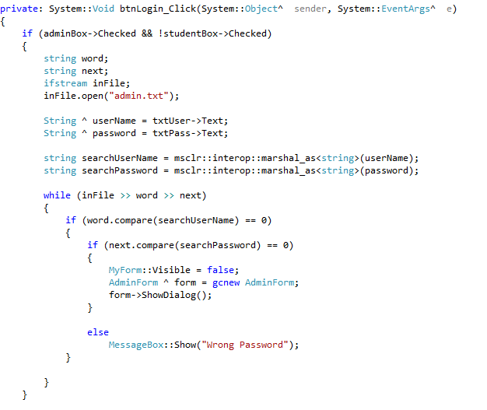
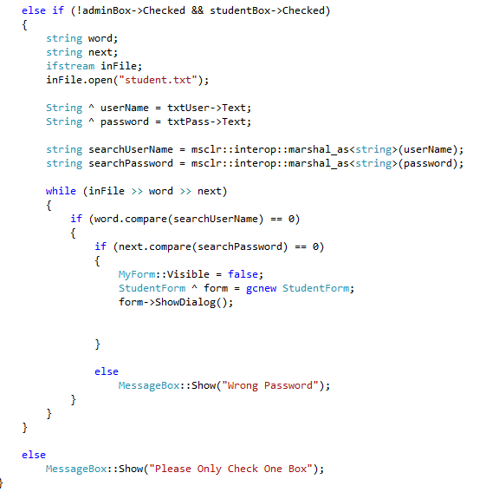
Waterfall Life-Cycle Model: Programming Code

Slide 23
Waterfall Life-Cycle: Website
GitHub
https://github.com/adriang2591/summer-project

Slide 24
The End
Question, comment, concerns?

